Slide 1

Micro:Bit An Educator’s Guide

Slide 2

Video Contents
Introducing the Micro:Bit
Using Makecode
Micro:Bit Classroom Software

Slide 3
About the Micro:Bit

Slide 4
What is a Micro:Bit?
Micro:Bits are small computers that can be programmed using a block-based language (similar to Scratch), JavaScript or Python.
They have several inputs and outputs available – depending on the version number.

Slide 5
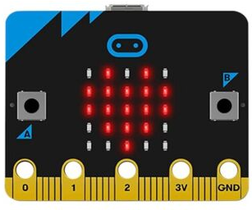
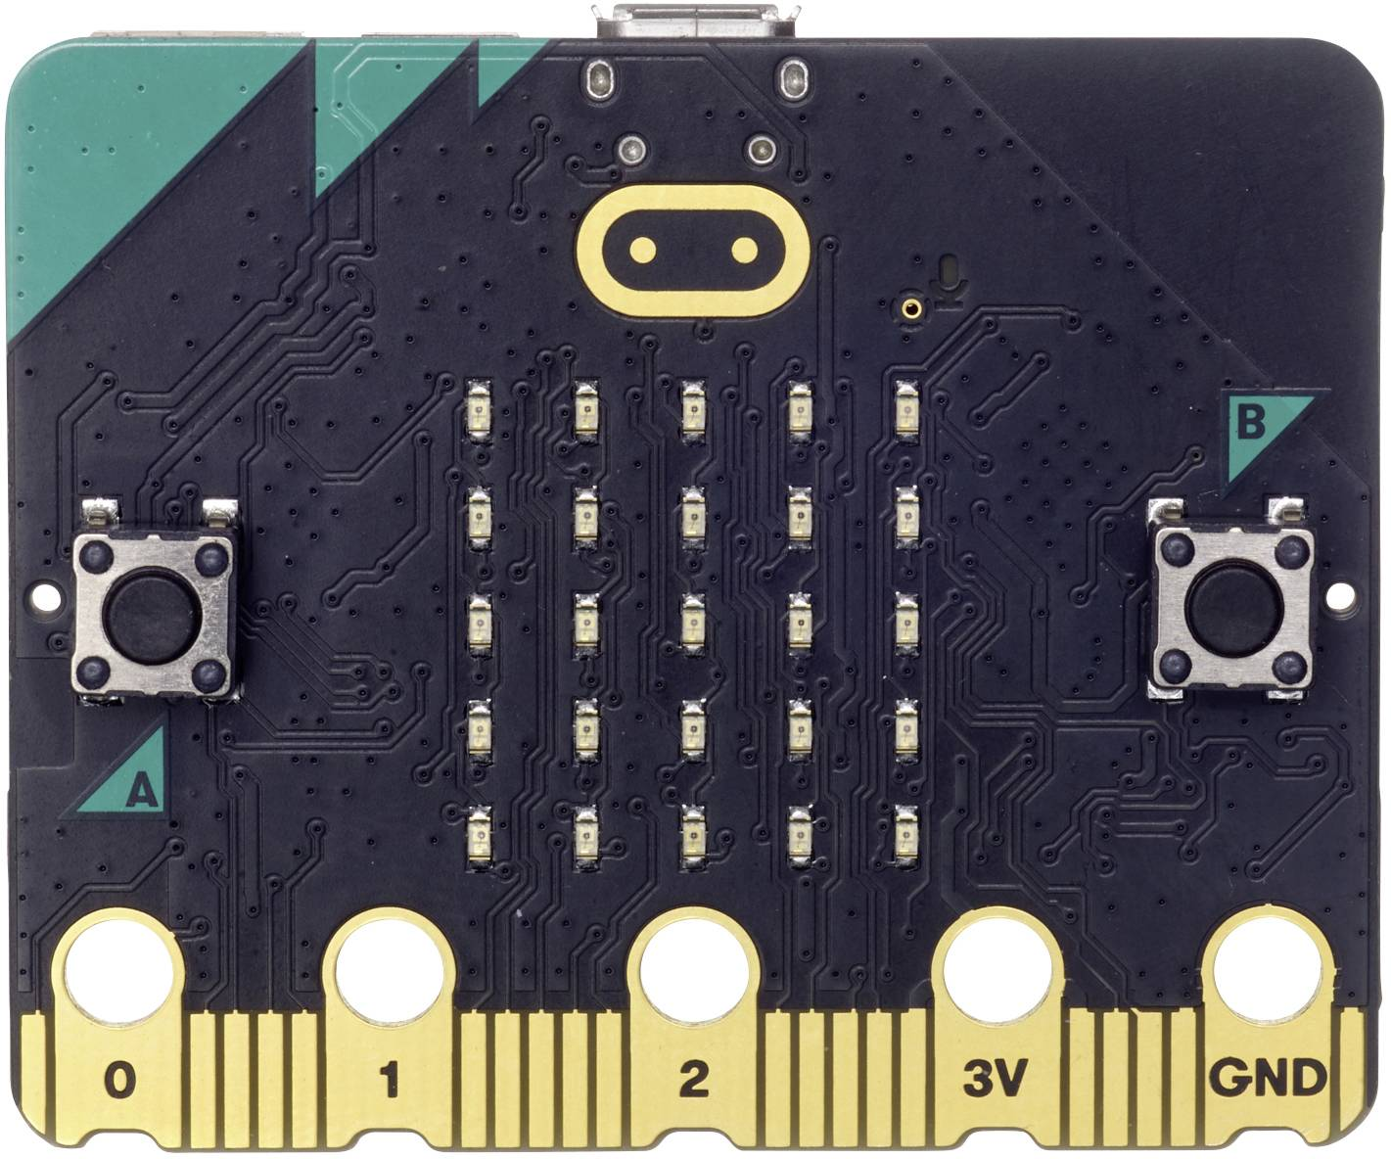
Version 1
Version 2

Slide 6
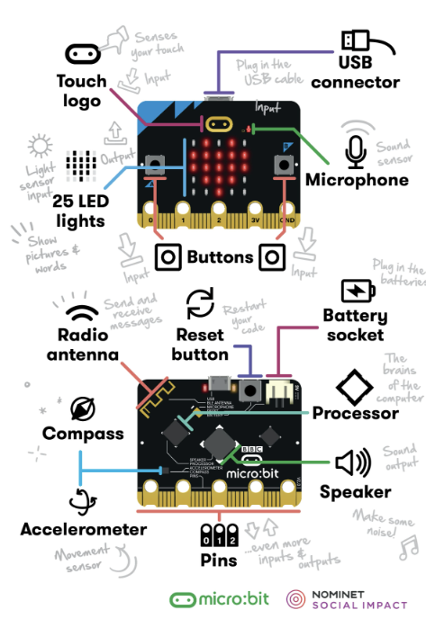

Slide 7
No Micro:Bit Required!
BBC Micro:Bits are programmed using block code in Microsoft Makecode. This is available in-browser or as a desktop app.
The software includes a simulator that can run the programs created without needing access to a Micro:Bit.
The simulator also replicates some components

Slide 8
Using Makecode

Slide 9
Makecode for Micro:Bits
https://makecode.microbit.org
There is a desktop version of this software available for offline usage. However, it lacks some functionality.

Slide 10
Downloading to a Micro:Bit
Need to connect and pair the device to the computer before downloading directly from Makecode.
Can only hold one program at a time.

Slide 11
Live Data
Need to connect the Micro:Bit to Makecode, download the program, and then you can few the data collection live.
Can also use radio communications between Micro:Bits to send live data to the computer.

Slide 12
Micro:Bit Classroom

Slide 13
Micro:Bit Classroom
Teachers can set up an online classroom. This allows you to see all pupils work, share a program with them, and edit their programs.
https://classroom.microbit.org/
These classroom sessions can be saved and re-opened at any time by the teacher.

Slide 14
Thank You

Slide 15
This presentation was bought to you by Aberystwyth University’s Computer Science Department.
We offer workshops and further resources for all ages.
For more details, please visit:
https://fbaps-outreach-hub.dcs.aber.ac.uk/CompSci/homePage.html
Thank you

